Slide 1
Smart Traffic Light System
UNITY SIMULATION PROJECT
Alper Kara

Slide 2
Project Overview
Our project aims to achieve traffic optimization in real time using dynamic data input. We plan to accomplish this by detecting the number of vehicles on the roads (waiting vehicles) through computer vision and processing the data using optimization algorithms.

Slide 3
System Design
Our project was developed in the Unity 3D simulation environment. A neural network model was trained for the vehicle detector in the computer vision module used for optimization.

Slide 4
Software Development Model
We used a hybrid approach combining the waterfall model and agile methodology. Throughout the project, coding, simulation design, testing, and development followed a structured process. However, based on our weekly meetings with our advisor, Öner Barut, we made necessary adjustments and modifications during development. As a result, our software development process both adhered to an overall plan and evolved dynamically according to project requirements.

Slide 5
Simulation Design
Simulation design is one of the most fundamental aspects of our project. Without visually conveying the story of traffic light optimization to the user, our project would have no meaningful impact. Therefore, we selected design elements that would ensure the most effective visual communication. The design of roads, sidewalks, traffic lights, and the four-way intersection was planned to maximize clarity and usability.
During development, we simultaneously researched how to implement optimization while familiarizing ourselves with Unity 3D. Since neither of us had previously worked with Unity, creating a design in a three-dimensional space was both challenging and a creatively rewarding experience.

Slide 6
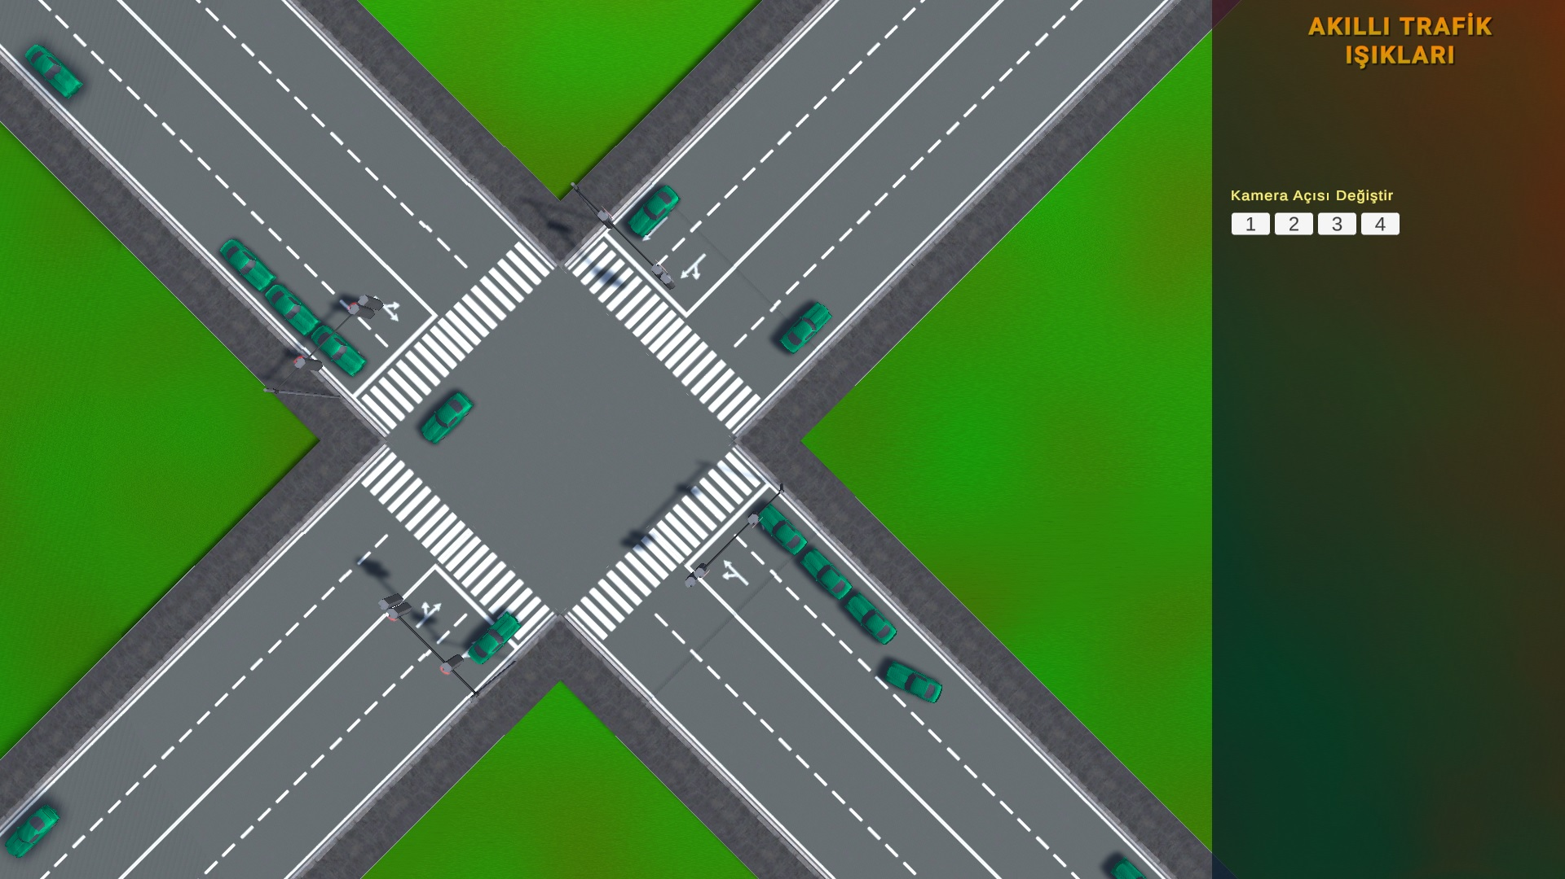

Slide 7
Testing
The simulation was tested using black-box testing and penetration testing methods. During these tests, we identified erroneous input parameters in the Vehicle Spawner code. We determined the necessary minimum distance between consecutive spawned vehicles and found that the four separate spawners needed to start spawning with slight variations in timing to increase randomness.
White-box testing was a continuous practice throughout development. We ensured that methods were correctly implemented, that the code was as efficient as possible, and that the simulation did not slow down the system. Variables that did not need to be public were set as private or protected to enhance code security.

Slide 8
User Interface Design
Once the simulation development is fully completed, a Unity build will be prepared for presentation. The user interface includes a top-down view of the four-way intersection, a 30-degree angled camera, and individual camera views for each of the four roads entering the intersection. Users will also have controls for randomization and vehicle speed. The interface will display improvements in waiting times at red lights due to traffic light optimization, showing how much waiting time has been reduced. Following the recommendation of Prof. Uraz, the system will also display the change in carbon emissions before and after optimization.

Slide 9
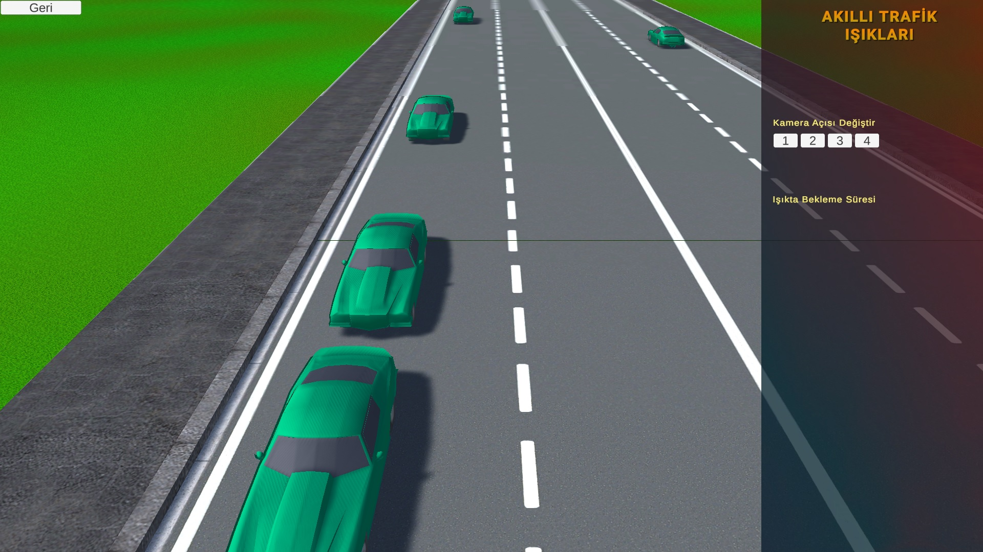

Slide 10
Conclusion
In conclusion, the design and simulation of the Smart Traffic Light System have been successfully completed. The experience gained and solutions developed in this project can serve as a guide for those interested in advancing traffic optimization. Ensuring proper maintenance and keeping the Unity version updated in the future is important.

